Slide 1
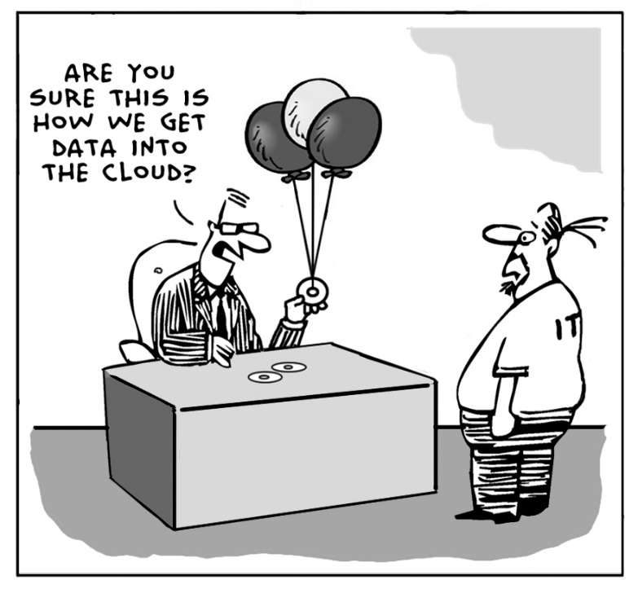
Upgrades
Upgrades: Central Office >> Dropbox >> Supervisor (sender) >> Bluetooth >> All Interviewers (receivers)

Slide 2
What?
Why?
When?
Who?
How?
Receiving updated programs and files
Fixing errors or changes in data collection programs
Whenever Central Office updates programs
Central Office, Supervisors, Interviewers
Dropbox and Bluetooth
Notes:
Central Office must notify supervisors when there is an update

Slide 3



Steps to Receive Upgrades
Supervisor receives upgrade from Central Office via Dropbox
Interviewers prepare to receive upgrades, Supervisor sends upgrades
Team confirms upgrade and restarts menus

Slide 4

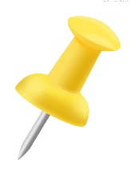

Supervisor receives upgrade
Connect to the Internet (modems), Dropbox will update automatically
Updated programs
Note: Central Office will notify Supervisors when upgrade is available

Slide 5
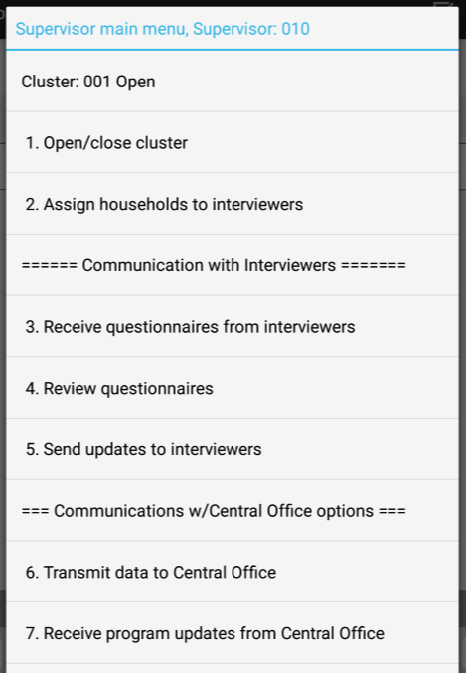

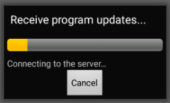
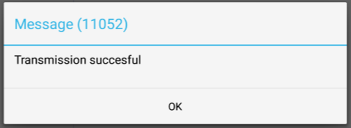
Supervisor receives upgrade
From supervisor main menu, choose option 7:

Slide 6
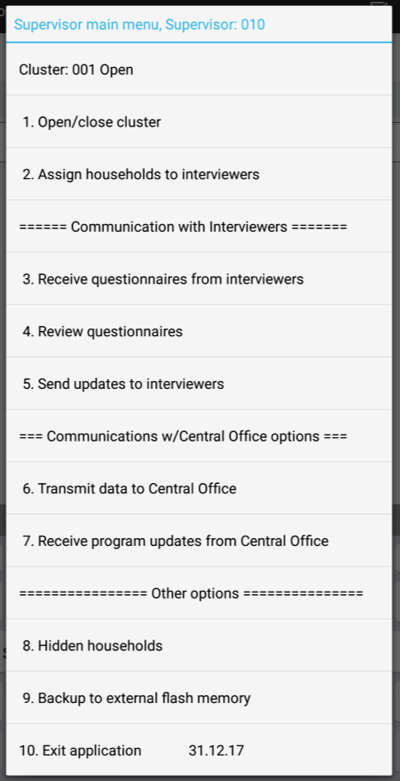
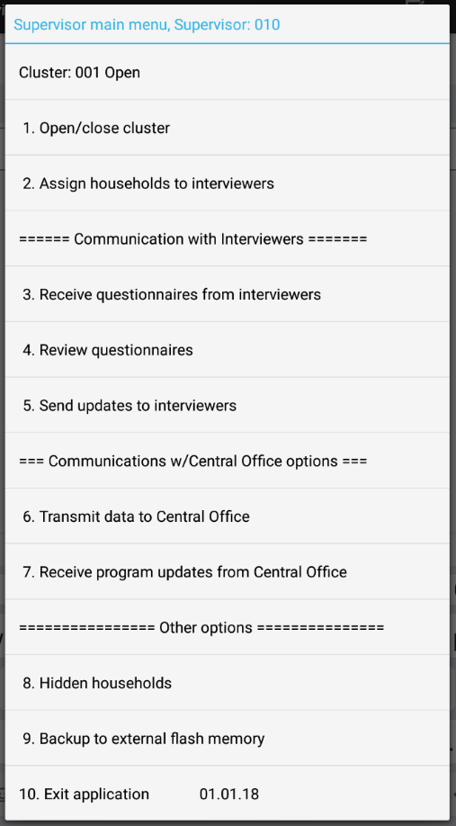
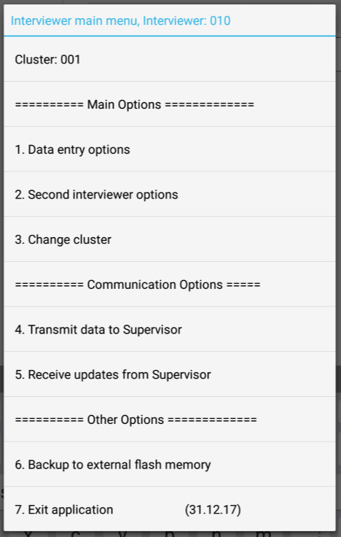
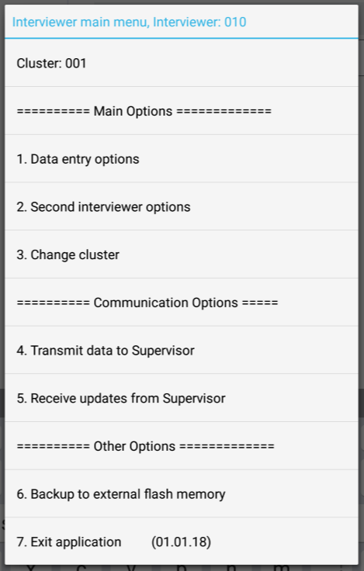
Supervisor receives upgrade
Check for a change in date on supervisor main menu:
UPGRADE
Notes:
After watching whole power point, while showing each slide once at a time, tell interviewers to gather around to watch

Slide 7
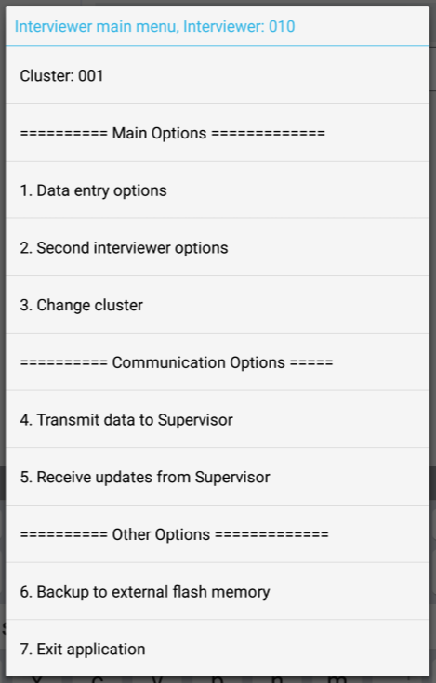

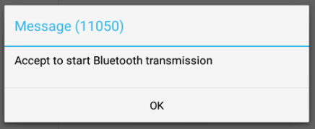
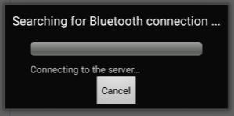
Interviewers prepare to receive upgrade
From interviewer main menu, choose option 5:
System begins searching for Bluetooth connection – interviewers tell supervisors they are ready…
-REVIEW-
Notes:
Once interviewers see Bluetooth box searching, tell supervisors they are ready to receive.

Slide 8
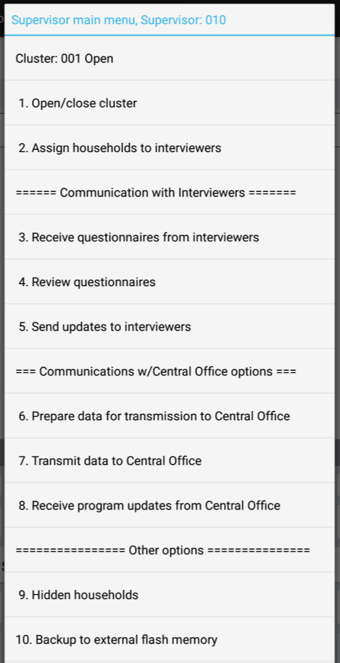

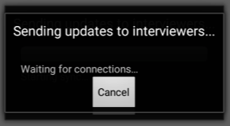
Supervisors send updates
From supervisor main menu, choose option 5:
System begins searching for Bluetooth connection with all interviewers…
-REVIEW-
Notes:
Supervisors will use this option anytime programs, files, assignments are changed!

Slide 9
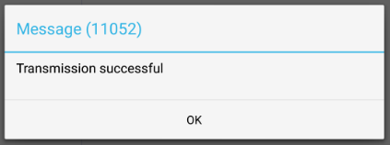
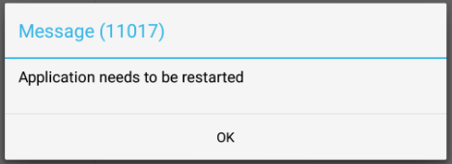
Transmission successful!
When successful, both interviewer and supervisor Bluetooth windows will close
Both supervisor and interviewers see this!
Only interviewers see this – and app will restart!
-REVIEW-
Notes:
What three possible reasons are there for not pairing?
Answer – interviewers are not trying to receive assignment; or Bluetooth did not make connection (so troubleshoot – check if it’s on, or try again); or interviewer was not listening/prepared to receive when supervisor started sending.

Slide 10
Interviewers confirm upgrade
Check for a change in date on interviewer main menu:
UPGRADE
SUCCESS!! SUCCESS!!
Notes:
What is the interviewer number for this list of households?
Which households were assigned?
What is Resp HH Member?

Slide 11
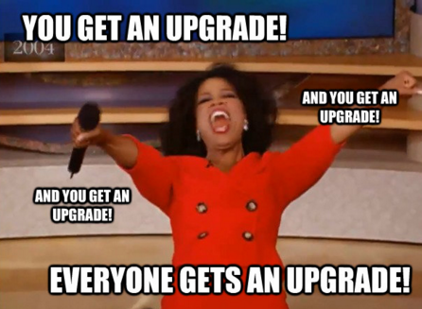
Practice time
There is an upgrade!
Supervisors should download and send it out...
Confirm upgrade – check date on menus!

